Slide 1

Investigating Influential Features on Coffee Quality
Yuqi Pan，Jin-an Wu，Shuqi Cao，Blair Watson，and Shenghan Gao
School of Mathematics and Statistics, University of Glasgow, UK

Slide 2
Content
01
02
Introduction
Explanatory Data Analysis
03
Formal Analysis
04
Conclusion
05
06
Further Extension
Reference

Slide 3
PART.01 Introduction

Slide 4
1.1 Research question
What influence do different features of coffee have on whether the quality of a batch of coffee is classified as good or poor?

Slide 5
1.2 Data description
Overview of the dataset
 | country_of_origin <chr> | aroma <dbl> | flavor <dbl> | acidity <dbl> | category_two_defects <int> | altitude_mean_meters <dbl>
1 | Myanmar | 7.25 | 7.42 | 7.50 | 4 | 1219.20
2 | Uganda | 8.33 | 7.92 | 7.92 | 1 | 1600.00
3 | Ethiopia | 8.42 | 8.00 | 8.00 | 7 | 1700.00
4 | Mexico | 7.17 | 7.08 | 7.25 | 3 | 1300.00
5 | Burundi | 7.75 | 7.67 | 7.50 | 5 | 1880.00
6 | Tanzania, United Republic Of | 7.92 | 7.75 | 7.75 | 0 | 1400.00
7 | Colombia | 7.92 | 7.83 | 7.67 | 1 | NA
8 | Colombia | 7.83 | 7.67 | 7.58 | 2 | 1775.00
9 | Guatemala | 7.00 | 6.83 | 7.17 | 2 | 1310.64
10 | Colombia | 7.33 | 7.33 | 7.50 | 1 | 1900.00

Slide 6
1.2 Data description
Response variable：
qualityclass
Explanatory variables：
country_of_origin
aroma
flavor
acidity
category_two_defects
altitiude_mean_meters
harvested

Slide 7
PART.02 Explanatory Data Analysis

Slide 8
2.1 Data summarization
Variables | Missing | Mean | SD | Min | Median | Max
aroma | 0 | 7.57 | 0.39 | 0 | 7.58 | 8.75
flavor | 0 | 7.52 | 0.40 | 0 | 7.58 | 8.67
acidity | 0 | 7.54 | 0.39 | 0 | 7.50 | 8.58
category_two_defects | 0 | 3.67 | 5.41 | 0 | 2.00 | 55.00
altitude_mean_meters | 201 | 1850.69 | 9392.09 | 1 | 1310.64 | 190164.00
harvested | 60 | 2013.67 | 1.81 | 2010 | 2014.00 | 2018.00

Slide 9
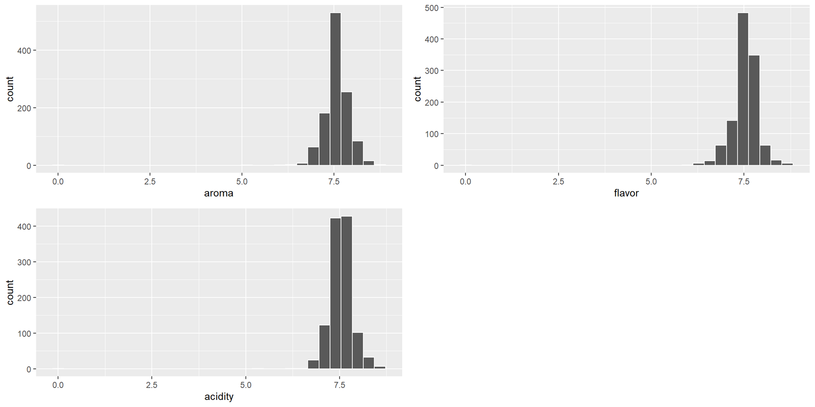
2.1 Data summarization
These histograms show that most of coffee beans get grades between 6 and 8.

Slide 10
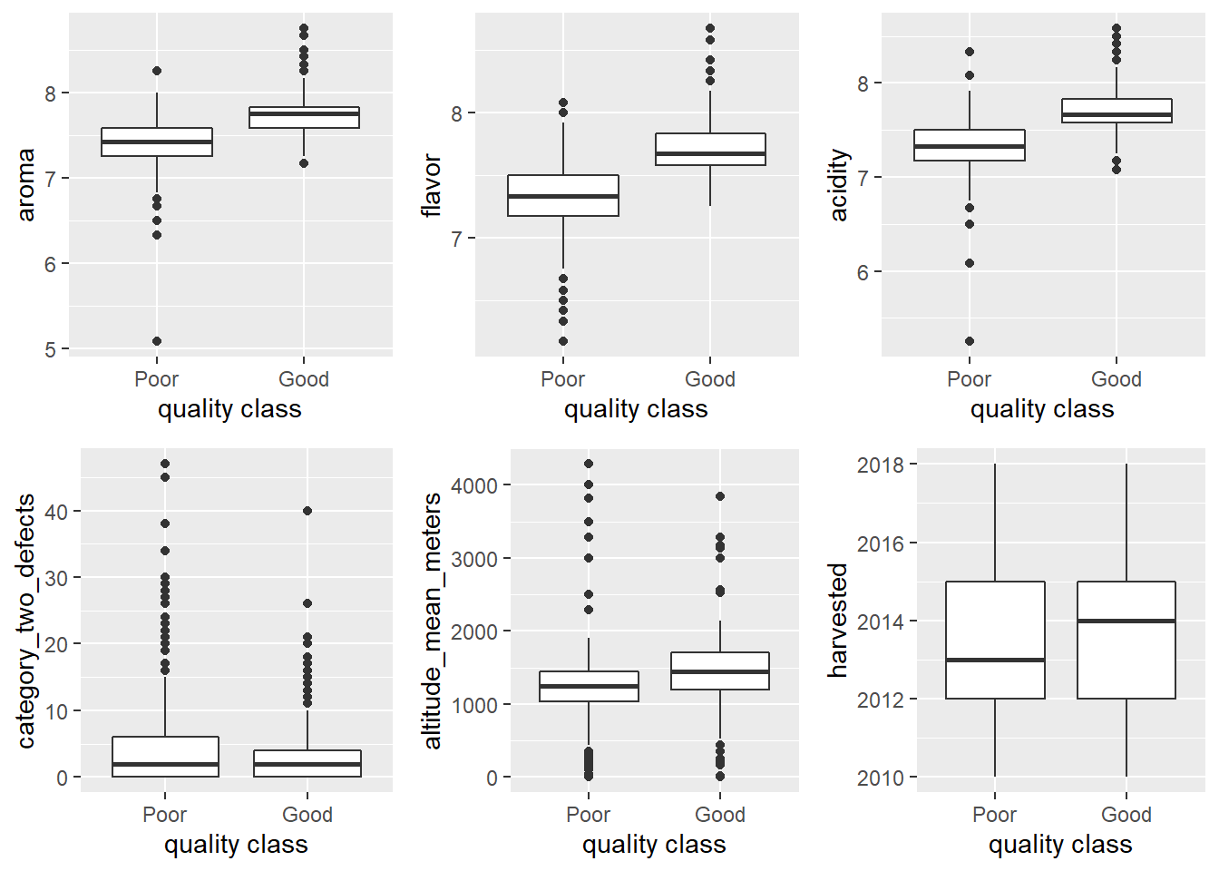
2.2 Data visualization
Boxplots of Quality class against the other variables

Slide 11
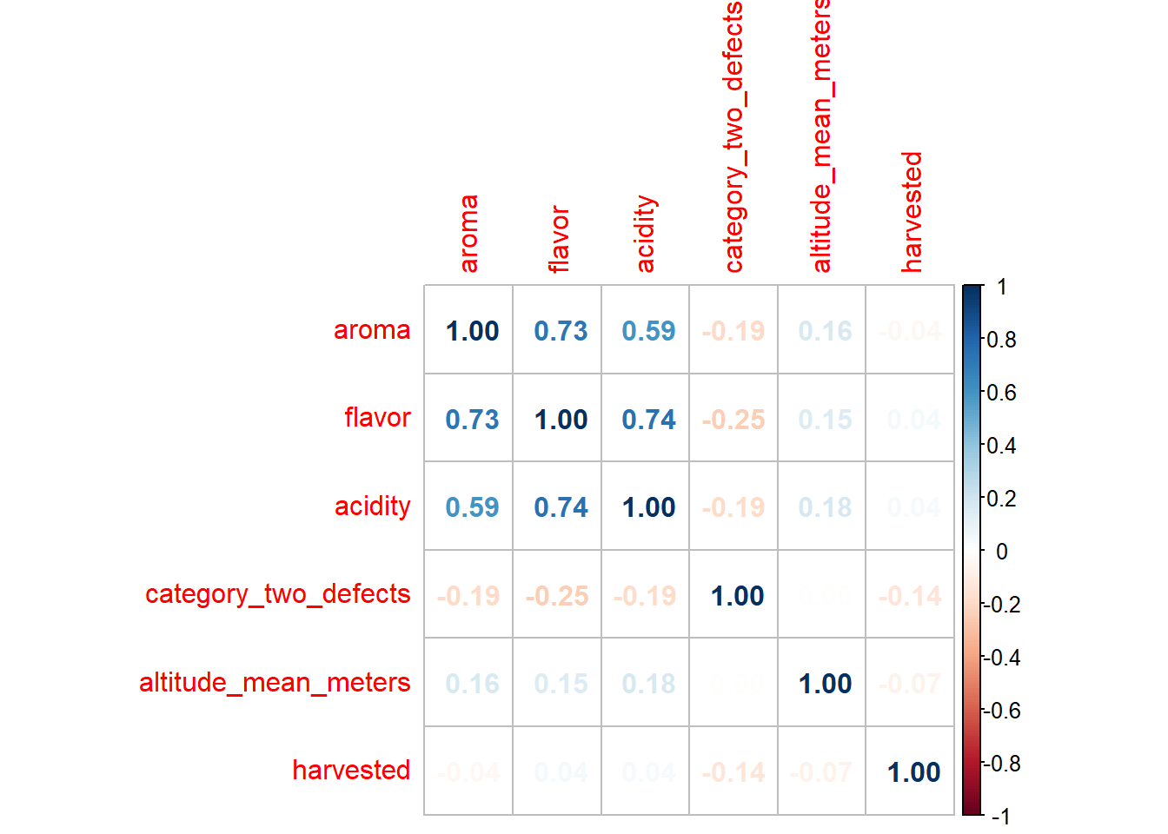
2.2 Data visualization
Correlation plot of all numerical variables

Slide 12
PART.03 Formal Analysis

Slide 13
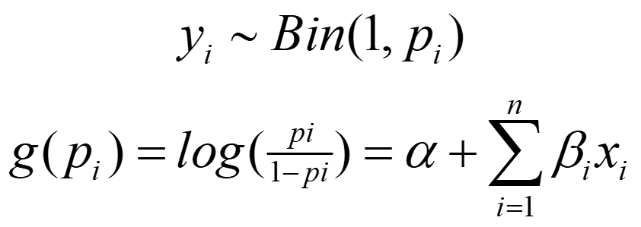
3 Formal Analysis
Generalized linear model

Slide 14
3.1 Multicollinearity
Variance inflation factor (VIF>10)
 | VIF
aroma | 1.042
flavor | 1.067
acidity | 1.033
category_two_defects | 1.012
altitude_mean_meters | 1.037
harvested | 1.053

Slide 15
3.1 Multicollinearity
Variance inflation factor (VIF>10)
 | VIF
aroma | 1.042
flavor | 1.067
acidity | 1.033
category_two_defects | 1.012
altitude_mean_meters | 1.037
harvested | 1.053

Slide 16
3.2 Log-odds
model 1
 | Est. | S.E. | z val. | p
(Intercept) | -283.59 | 118.31 | -2.40 | 0.02
aroma | 4.66 | 0.69 | 6.77 | 0.00
flavor | 7.20 | 0.85 | 8.47 | 0.00
acidity | 4.21 | 0.67 | 6.25 | 0.00
category_two_defects | 0.00 | 0.03 | 0.14 | 0.89
altitude_mean_meters | 0.00 | 0.00 | 2.68 | 0.01
harvested | 0.08 | 0.06 | 1.38 | 0.17

Slide 17
3.2 Log-odds
model 2
 | Est. | S.E. | z val. | p
(Intercept) | -282.39 | 117.98 | -2.39 | 0.02
aroma | 4.66 | 0.69 | 6.77 | 0.00
flavor | 7.20 | 0.85 | 8.48 | 0.00
acidity | 4.20 | 0.67 | 6.25 | 0.00
altitude_mean_meters | 0.00 | 0.00 | 2.69 | 0.01
harvested | 0.08 | 0.06 | 1.37 | 0.17

Slide 18
3.2 Log-odds
model 3
 | Est. | S.E. | z val. | p
(Intercept) | -121.42 | 8.66 | -14.02 | 0.00
aroma | 4.53 | 0.68 | 6.67 | 0.00
flavor | 7.19 | 0.85 | 8.48 | 0.00
acidity | 4.27 | 0.67 | 6.33 | 0.00
altitude_mean_meters | 0.00 | 0.00 | 2.53 | 0.01

Slide 19
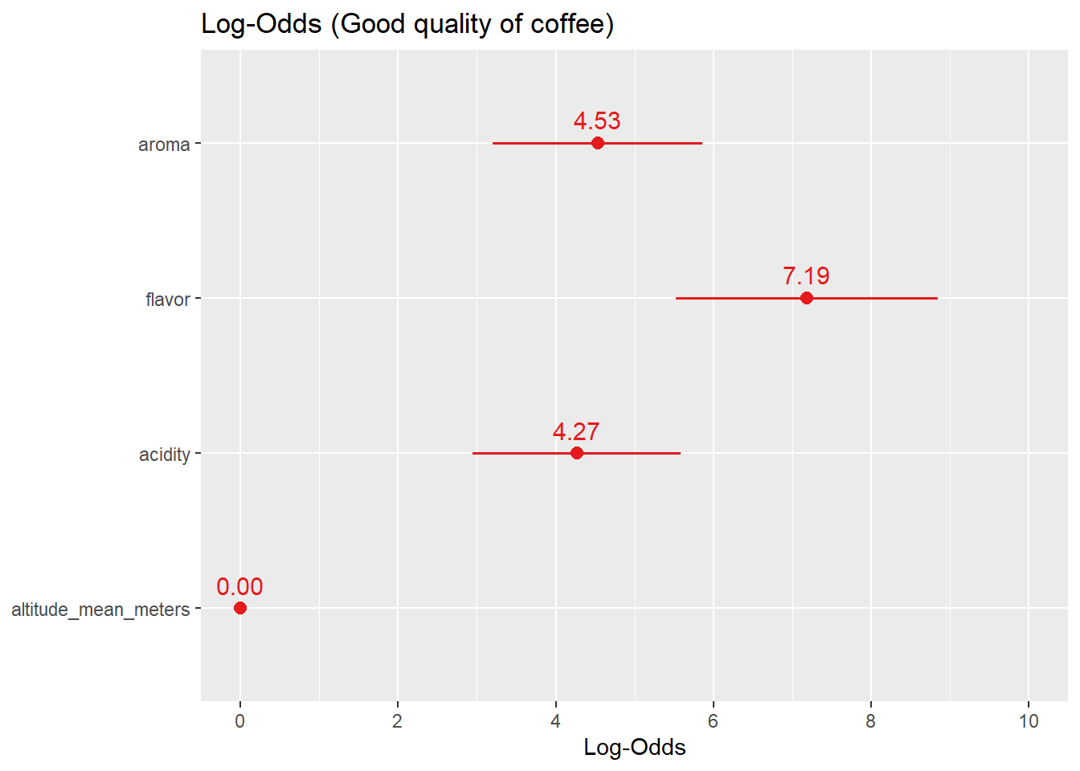
The bound of 95% confidence interval for altitude_mean_meters is almost zero
3.2 Log-odds
95% confidence interval for log-odds
 | 2.5 % | 97.5 %
(Intercept) | -139.331 | -105.328
aroma | 3.238 | 5.906
flavor | 5.587 | 8.914
acidity | 2.971 | 5.617
altitude_mean_meters | 0.000 | 0.001
The bound of 95% confidence interval for altitude_mean_meters is almost zero.

Slide 20
3.2 Log-odds
model 4
 | Est. | S.E. | z val. | p
(Intercept) | -120.66 | 8.54 | -14.12 | 0.00
aroma | 4.66 | 0.68 | 6.87 | 0.00
flavor | 7.00 | 0.83 | 8.39 | 0.00
acidity | 4.33 | 0.67 | 6.50 | 0.00

Slide 21
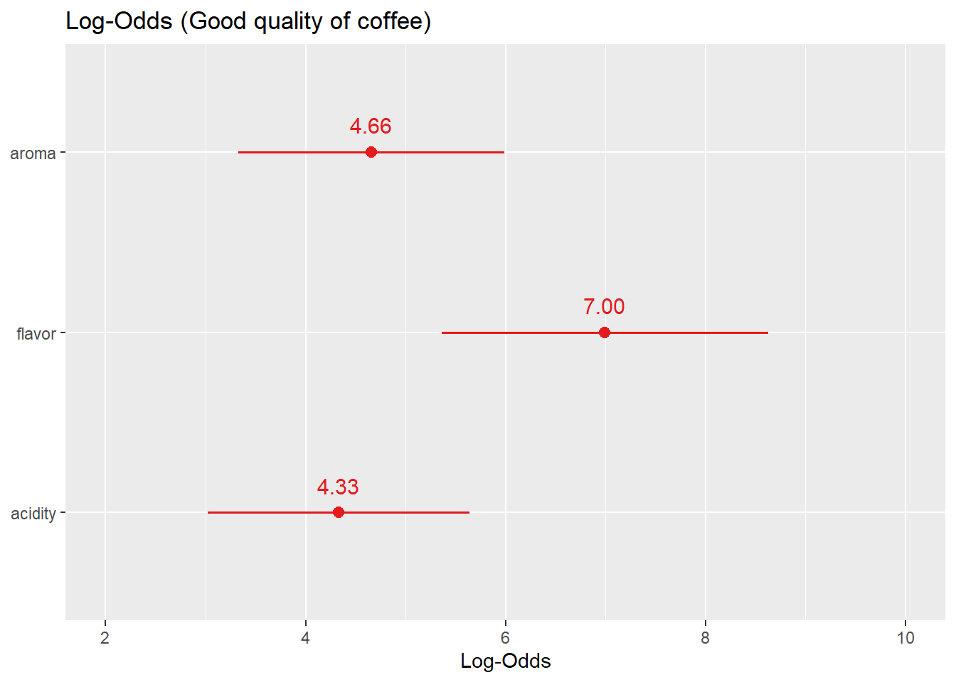
3.2 Log-odds
95% confidence interval for log-odds
 | 2.5 % | 97.5 %
(Intercept) | -138.309 | -104.773
aroma | 3.363 | 6.025
flavor | 5.418 | 8.692
acidity | 3.050 | 5.667

Slide 22
3.3 Model selection
Model comparison values for different models
model | AIC | BIC
GLM1 | 562.357 | 596.203
GLM2 | 560.376 | 589.387
GLM3 | 560.263 | 584.439
GLM4 | 564.616 | 583.957
Final model on the log-odds scale

Slide 23
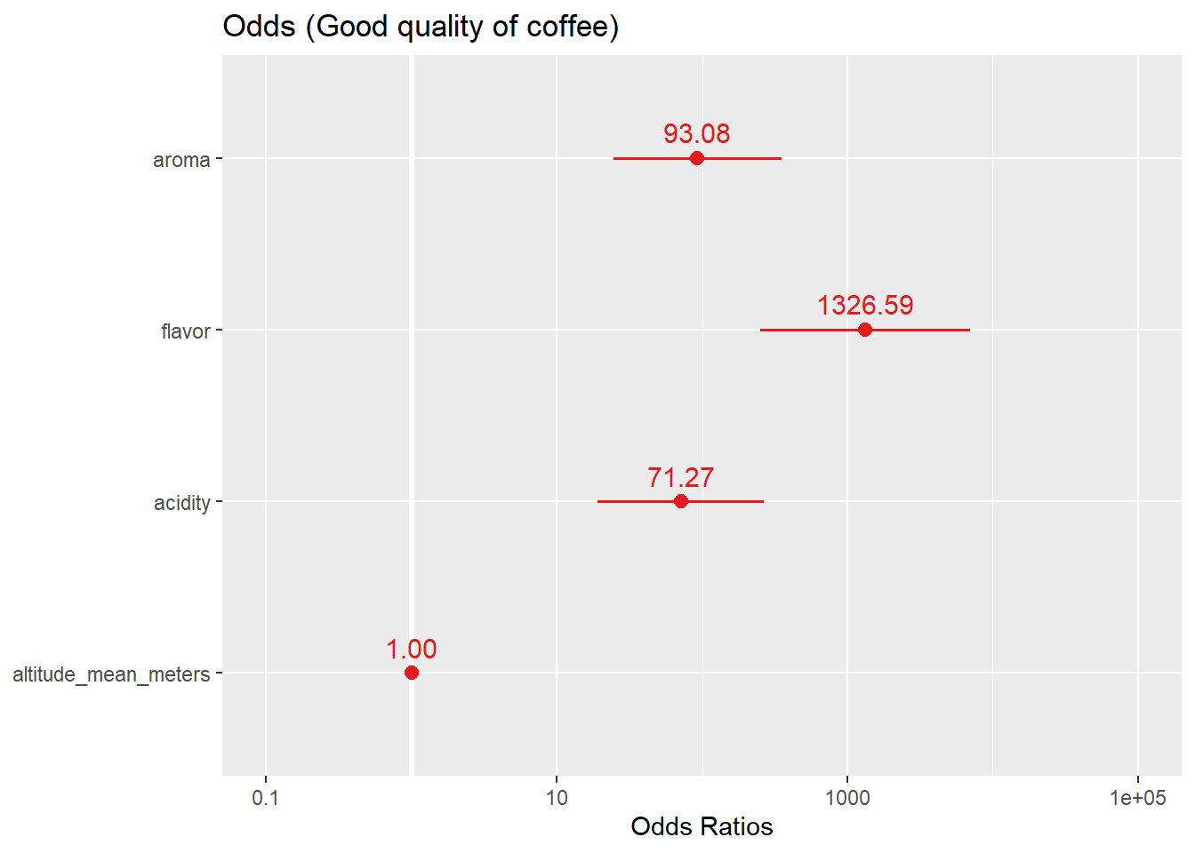
3.4 Odds
Odds (Good quality of coffee)
 | Odds
(Intercept) | 0.000
aroma | 93.075
flavor | 1326.589
acidity | 71.268
altitude_mean_meters | 1.001

Slide 24
3.5 Probabilities
Probability formula
An example

Slide 25
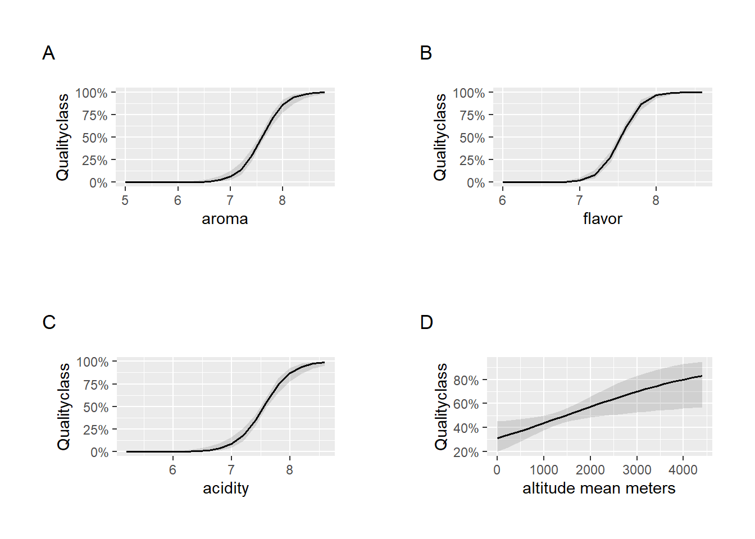
3.5 Probabilities
Probability of being good quality of coffee beans
The probability approaches 100% the larger the explanatory variables get, and approaches 0% the smaller the explanatory variables get.

Slide 26
PART.04 Conclusion

Slide 27
5 Conclusion
Choose model 3 as the final model.
The main three factors affecting the quality of coffee are aroma, flavor and acidity .
Flavor is the most influential factor.

Slide 28
PART.05 Further Extension

Slide 29
6 Further Extension
Delve into the causes of missing values
Further work of this data
e.g., looking at the PH of the soil and how tall the plant grew.

Slide 30
PART.06 Reference

Slide 31
6 Reference
[1] Kutner, M. H.; Nachtsheim, C. J.; Neter, J. (2004). Applied Linear Regression Models (4th ed.). McGraw-Hill Irwin.
[2] ccs-amsterdam/r-course-material. GitHub. (2021). Retrieved 17 July 2021, from https://github.com/ccs-amsterdam/r-course-material/blob/master/tutorials/advanced_modeling.md#multilevel-models-or-mixed-effects-models.

